Slide 1
Coding Systems (ASCII, Unicode & Error Checking)
LO: To understand how characters are represented by a computer & error checking

Slide 2
Coding Systems (ASCII, Unicode & Error Checking)
LO: To understand how characters are represented by a computer & error checking
Specification Points
3.5.5.1 Character form of a decimal digit
3.5.5.2 ASCII and Unicode
3.5.5.3 Error checking and correction

Slide 3
Coding Systems (ASCII, Unicode & Error Checking)
LO: To understand how characters are represented by a computer & error checking
ASCII
In the early days of computing, programmers would combine groups (sequences) of 0s and 1s to represent different things.
For example, they might decide that 00000000 could be used to represent an A, and 00000001 could be used to represent a B, and so on.
The problem was that different programmers used their own coding systems, so the sequences meant different things to different people.
A standard was agreed upon for the representation of all the keyboard characters, including the numbers, and other commonly used functions.
This standard is called ASCII or the American Standard Code for Information Interchange.
In fact, a 7-bit code was agreed upon as 7 bits gives 128 permutations, which is enough for the most commonly used characters.

Slide 4
Coding Systems (ASCII, Unicode & Error Checking)
LO: To understand how characters are represented by a computer & error checking
Problems with ASCII
128 characters are not sufficient to represent all of the possible characters, numbers and symbols.
It was initially developed in English and therefore did not represent all of the other languages and scripts in the world.
Widespread use of the web made it more important to have a universal international coding system.
The range of platforms and programs has increased dramatically with more developers from around the world using a much wider range.

Slide 5
Coding Systems (ASCII, Unicode & Error Checking)
LO: To understand how characters are represented by a computer & error checking
Unicode
A new standard has emerged called Unicode which follows the same basic principles as ASCII.
ASCII codes have been subsumed within Unicode meaning that the ASCII code for a capital letter ‘A’ is 65 and so is the Unicode code for the same character.
Unicode also includes international characters for over 20 countries and even includes conversions of classical and ancient characters.

Slide 6
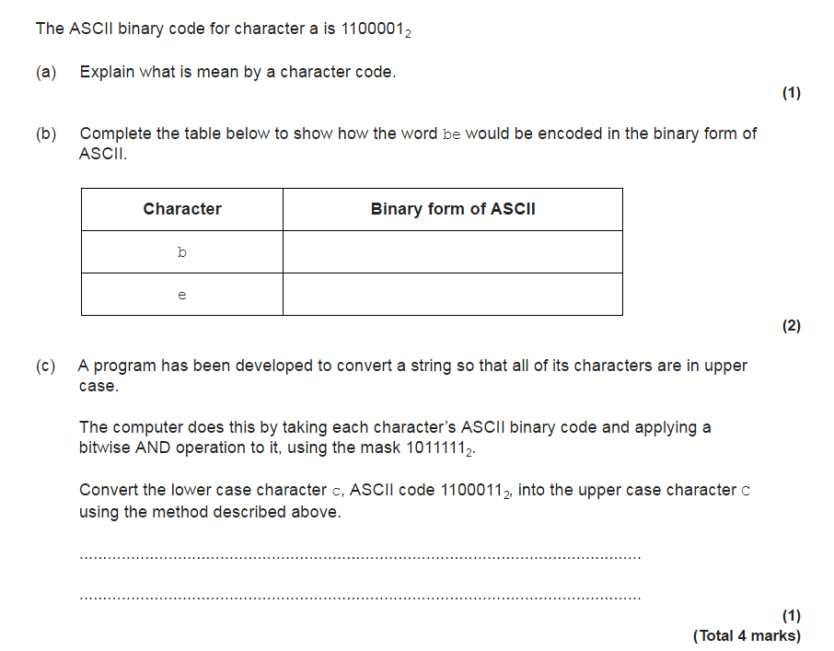
Coding Systems (ASCII, Unicode & Error Checking)
LO: To understand how characters are represented by a computer & error checking
Exam Question 1

Slide 7

Coding Systems (ASCII, Unicode & Error Checking)
LO: To understand how characters are represented by a computer & error checking
Exam Answer 1

Slide 8
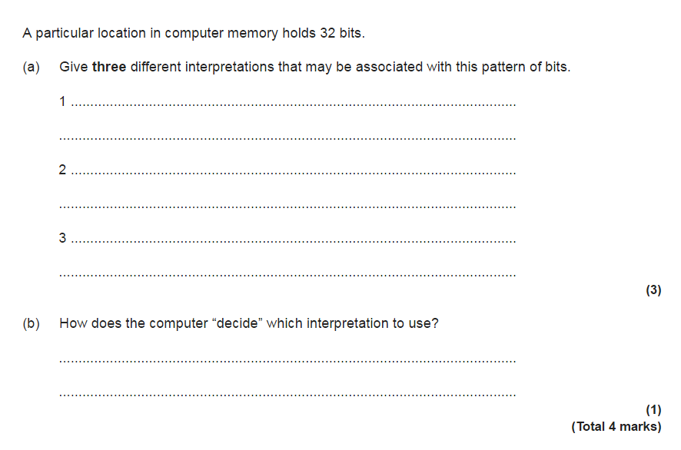
Coding Systems (ASCII, Unicode & Error Checking)
LO: To understand how characters are represented by a computer & error checking
Exam Question 2

Slide 9
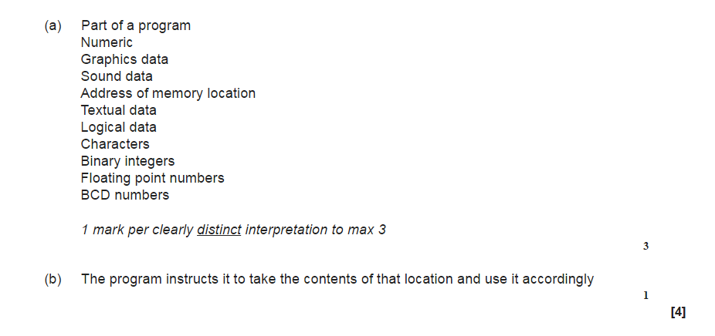
Coding Systems (ASCII, Unicode & Error Checking)
LO: To understand how characters are represented by a computer & error checking
Exam answer 2

Slide 10
Coding Systems (ASCII, Unicode & Error Checking)
LO: To understand how characters are represented by a computer & error checking
Parity Bits
A parity bit is a method of detecting errors in data during transmission. One method for detecting errors is to count the number of ones in each byte before the data is sent to see whether there is an even or odd number. At the receiving end, the code can be checked to see whether the number is still odd or even.
Even parity: The number of 1s in the code are counted. If there are an odd number of 1s, the parity bit is set to one to make the total number of 1s even.
Odd parity: The number of 1s in the code are counted. If there are an even number of 1s, the parity bit is set to one to make the total number of 1s odd.

Slide 11
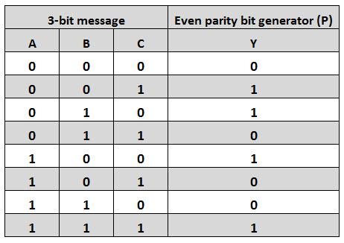
Coding Systems (ASCII, Unicode & Error Checking)
LO: To understand how characters are represented by a computer & error checking

Slide 12
Question 1
Suppose you are using an odd parity. What should the binary word “1010” look like after you add the parity bit?
Answer:
There is an even number of 1-bits.
So we need to add another 1-bit
Our new word will look like “10101”.

Slide 13
Question 2
Suppose you are using an even parity. What should the binary word “1010” look like after you add a parity bit?
Answer:
There is an even number of 1’s.
So we need to add another 0
Our new word will look like “10100”.

Slide 14
Coding Systems (ASCII, Unicode & Error Checking)
LO: To understand how characters are represented by a computer & error checking
Majority Voting
Majority voting is another method of identifying errors in transmitted data.
In this case, each bit is sent three times. So the binary code 1001 would be sent as: 111000000111.
This same principle can also be applied on a larger scale, for example with whole systems being used to check against each other.
1 1 1 0 0 0 0 0 0 1 1 1
1001

Slide 15
Coding Systems (ASCII, Unicode & Error Checking)
LO: To understand how characters are represented by a computer & error checking
Majority Voting
Majority voting is another method of identifying errors in transmitted data.
In this case, each bit is sent three times. So the binary code 1001 would be sent as: 111000000111.
This same principle can also be applied on a larger scale, for example with whole systems being used to check against each other.
1 1 1 0 0 0 0 0 0 1 1 1
1001 1001

Slide 16
Coding Systems (ASCII, Unicode & Error Checking)
LO: To understand how characters are represented by a computer & error checking
Majority Voting
Majority voting is another method of identifying errors in transmitted data.
In this case, each bit is sent three times. So the binary code 1001 would be sent as: 111000000111.
This same principle can also be applied on a larger scale, for example with whole systems being used to check against each other.
1 1 1 0 0 0 0 0 0 1 1 1
1001 1001 1001

Slide 17
Coding Systems (ASCII, Unicode & Error Checking)
LO: To understand how characters are represented by a computer & error checking
Majority Voting
Majority voting is another method of identifying errors in transmitted data.
In this case, each bit is sent three times. So the binary code 1001 would be sent as: 111000000111.
This same principle can also be applied on a larger scale, for example with whole systems being used to check against each other.

Slide 18
Coding Systems (ASCII, Unicode & Error Checking)
LO: To understand how characters are represented by a computer & error checking
Check Digits
Check digits are a common way of checking data often when it is being entered into a computer.
Like a parity bit, a check digit is a value that is added to the end of a number to try to ensure that the number is not corrupted in any way.
The check digit is created by taking the digits that make up the number itself and using them in some way to create a single digit.
The simplest is to add the digits of the number together, and keep on adding the digits until you have only a single digit remaining.
So the digits of 123456 add up to 21 and 2 and 1 in turn add up to 3, so the number with its check digit becomes 1234563.

Slide 19
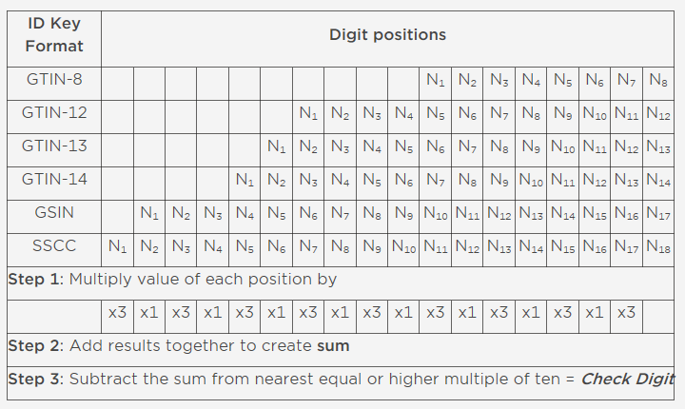
Coding Systems (ASCII, Unicode & Error Checking)
LO: To understand how characters are represented by a computer & error checking
An example of calculating check digits

Slide 20
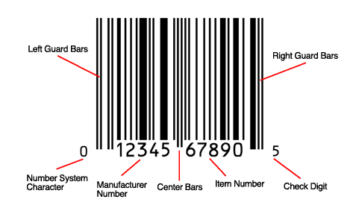
Coding Systems (ASCII, Unicode & Error Checking)
LO: To understand how characters are represented by a computer & error checking
An example of calculating check digits
 | 1 | 2 | 3 | 4 | 5 | 6 | 7 | 8 | 9 | 0
x | 3 | 1 | 3 | 1 | 3 | 1 | 3 | 1 | 3 | 1
 | 3 | 2 | 9 | 4 | 15 | 6 | 21 | 8 | 27 | 0
= 95
100 – 95 = 5

Slide 21
Coding Systems (ASCII, Unicode & Error Checking)
LO: To understand how characters are represented by a computer & error checking
Plenary
In bullet points, answer the following questions:
What is ASCII?
Why was Unicode created?
Why is it important to check transmitted data for errors?
How does even parity work?
What is a check digit?
How does majority voting work to check transmitted data?

Slide 22
Coding Systems (ASCII, Unicode & Error Checking)
LO: To understand how characters are represented by a computer & error checking
Prep

Slide 23















Key words:
Noted clearly
Topic specific vocabulary wherever necessary
Icon for extension activity if appropriate
Icon same colour as dept ex book
You might want to develop subject specific icons

